Slide 1
Quicksort Algorithm
Higher Level only

Slide 2
Quicksort
The Quicksort algorithm is recursive.
That means that the sorting algorithm is recursively repeated on subsets (sublists) of the same problem until a specific endpoint is reached - in this case the end point is when there is only one element in the list.

Slide 3
Quicksort
First , the algorithm starts by defining a pivot value. There are several options for this, such as selecting the first or last item in the list. We are going to use the last item in the list for our example
The first thing Quicksort does is create two sublists.
The first sublist is all the values in the list (excluding the pivot value) that are less than the pivot value.
The second sublist is all the values in the list (excluding the pivot value) that are greater than or equal to the pivot value.

Slide 4
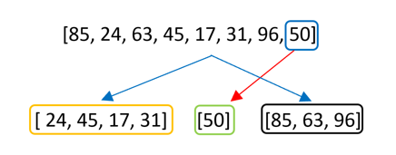
The pivot value is the last item - 50
There are two sublists created - one with all values less than 50 and one with all values greater than 50
The list has started to be sorted.

Slide 5

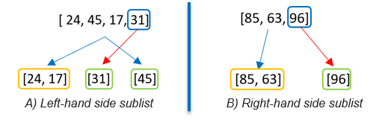
If at this point the algorithm concatenated (put together) the three separate lists, it would look like this
But before the sublists are concatenated, ,the Quicksort algorithm is recursively called on the left hand side sublist and also on the right hand side sublist.
This means that the algorithm is repeated on each sublist
The algorithm is then recursively applied again to each new set in the same way. It keeps going until all the sublists are of length one. The algorithm can then stop

Slide 6
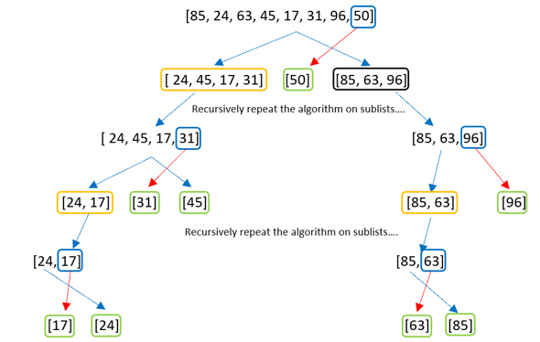

Once all the sublists have a length of 1, they are returned, now in order to create a sorted list.

Slide 7
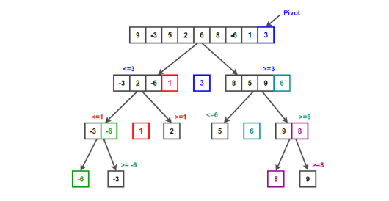
Quicksort Example
https://www.techiedelight.com/quicksort/

Slide 8
Python Code
https://repl.it/@suzannelinnane/Quicksort

